Slide 1

NOVEMBER 2023
HOW TO TRAIN YOUR ELECTRON
Anderson localization on the lattice & random graphs
PATRICK DEVANEY, RAVI KOKA, ANISH PANDYA, ABBY PERRYMAN
Department of Physics, The University of Texas at Austin

Slide 2
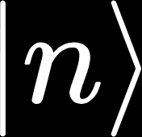





The Tight Binding Model
Goal: understand how an electron behaves in a material
For simplicity, think of an electron on an atomic ring:
The n^{th} atom has a single orbital, labelled
We represent the wavefunction in the site basis
The electron can hop between nearby sites
Simon, Steven. “Solid State Basics,” Oxford University Press, 2013.
Notes:
Approach used to calculate the electronic band structure of material systems by making approximate wave functions

Slide 3
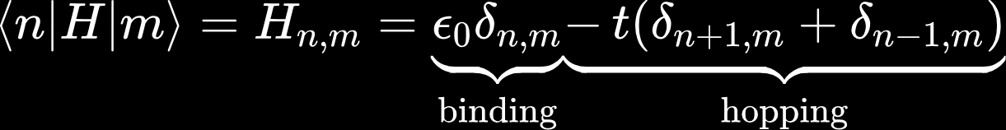

The Tight Binding Hamiltonian
The tight binding hamiltonian:
where refers to the energy at a site and t is the hopping parameter
Hamiltonian ~ Time Evolution
This is typically diffusive!!
Simon, Steven. “Solid State Basics,” Oxford University Press, 2013.
Notes:
Approach used to calculate the electronic band structure of material systems by making approximate wave functions

Slide 4
Numerical Approach
Given a hamiltonian, we can time evolve the wave function:
Notes:
Approach used to calculate the electronic band structure of material systems by making approximate wave functions

Slide 5
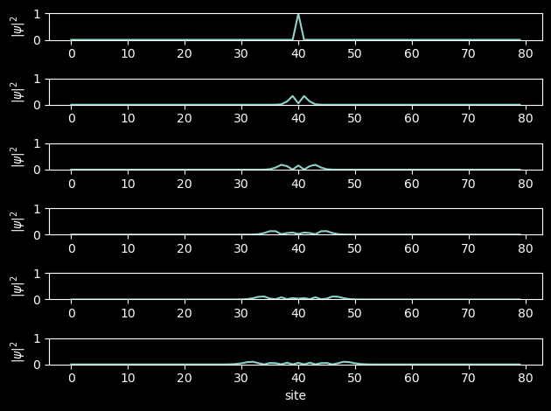
Numerical Approach
Given a hamiltonian, we can time evolve the wave function:
Notes:
Approach used to calculate the electronic band structure of material systems by making approximate wave functions

Slide 6

Anderson Localization
Counterintuitively, we can get localization by modifying tight binding.
Key idea: randomly sample values of from a uniform distribution from [-W, W]
Randomizing the diagonal of H
Represents a disordered material
Larger W = more localized
Simon, Steven. “Solid State Basics,” Oxford University Press, 2013.
Notes:
Approach used to calculate the electronic band structure of material systems by making approximate wave functions

Slide 7
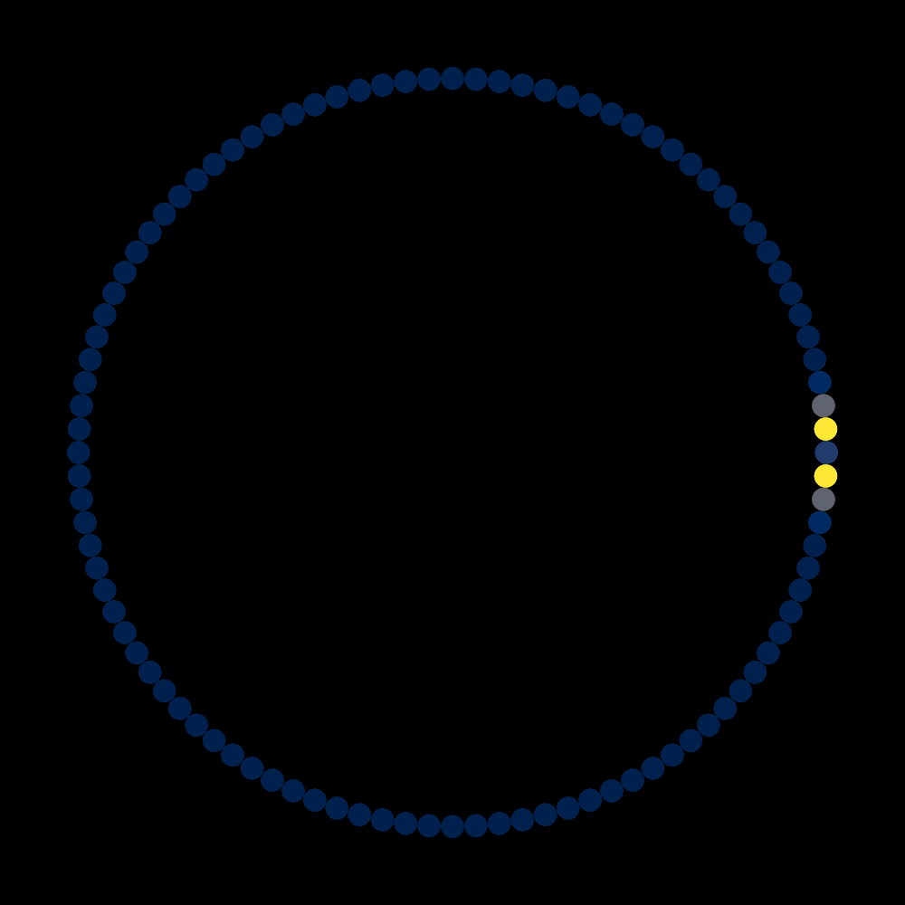
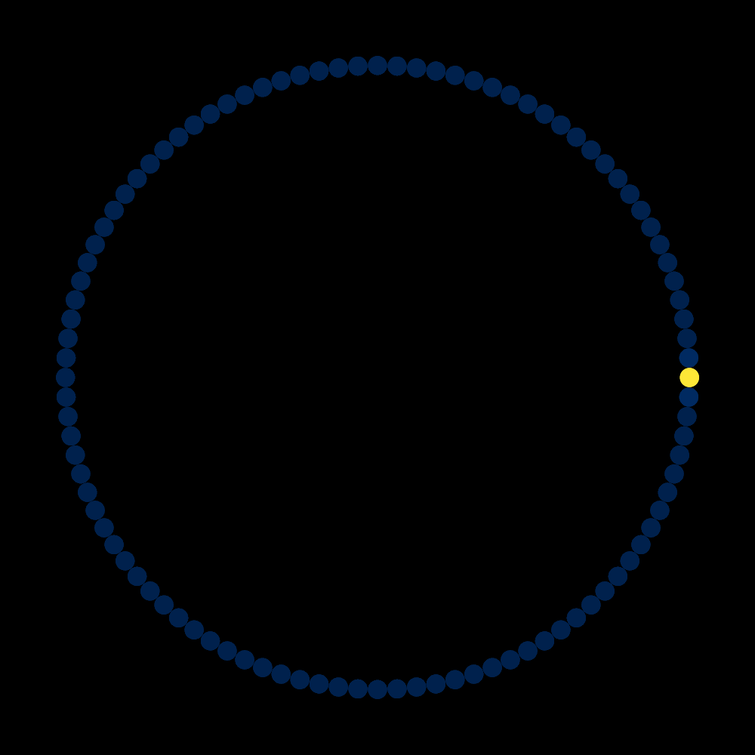
Anderson Localization on the Ring
One ring to rule them all,
one ring to find them,
One ring to bring them all
and in the darkness bind them.
W = 0
W = 10
Notes:
Approach used to calculate the electronic band structure of material systems by making approximate wave functions

Slide 8
Anderson Localization on a Graph
We can identify the hopping term with the adjacency matrix of a graph
This allows us to extend to more interesting configurations*
*we assume periodic boundary conditions
Notes:
Approach used to calculate the electronic band structure of material systems by making approximate wave functions

Slide 9
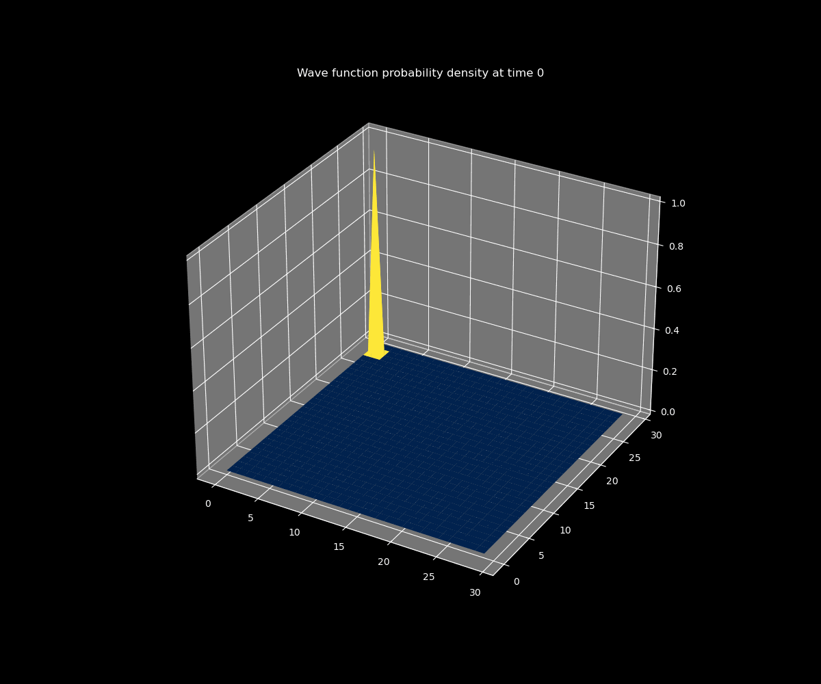
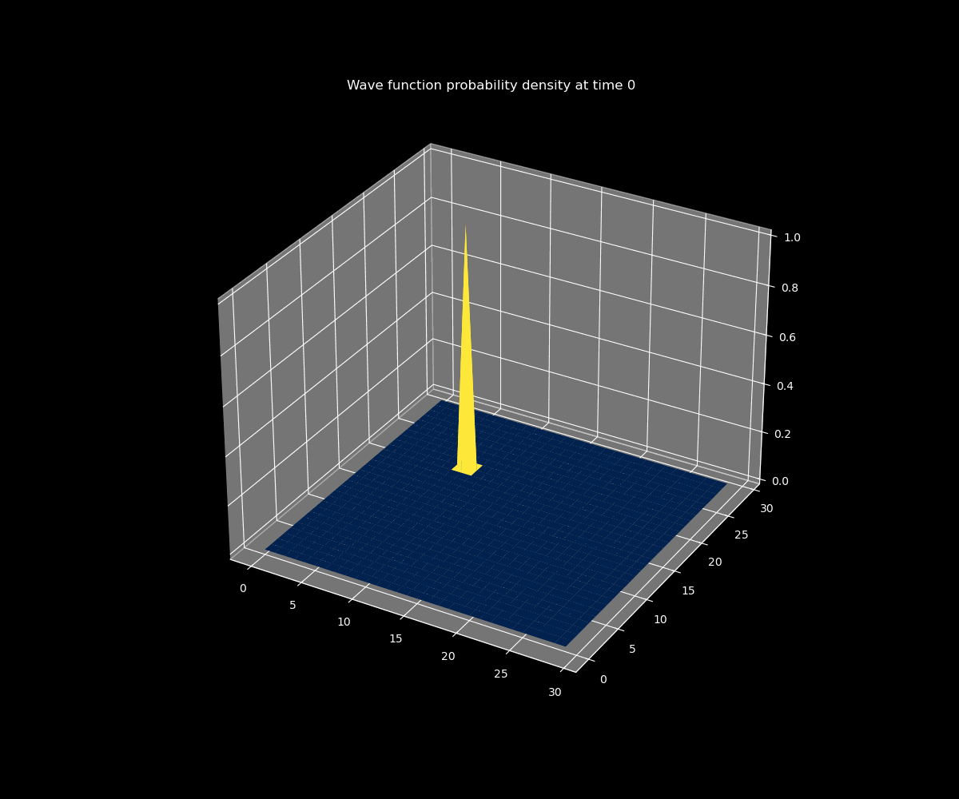
Anderson Localization on a Periodic Lattice
Consider a 2D lattice with periodic boundary conditions.
For low W, the wave function diffuses. For high W, we see localization
W = 0
W = 10
Notes:
Approach used to calculate the electronic band structure of material systems by making approximate wave functions

Slide 10
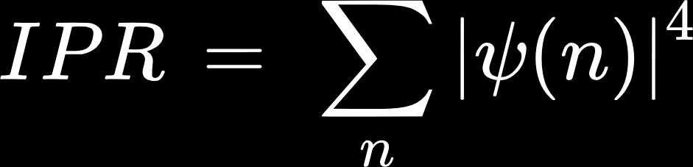
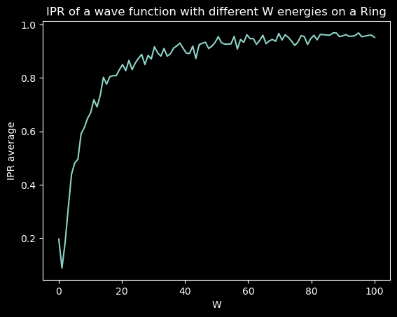
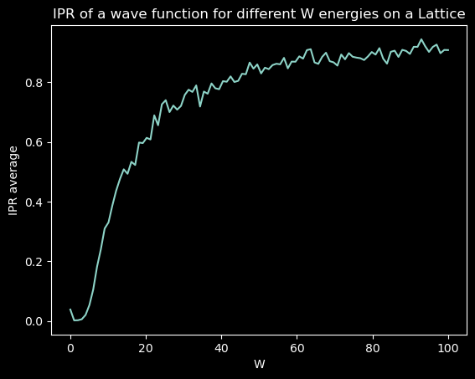
Inverse Participation Ratio (IPR)
IPR is a rough measure of localization. IPR of 1 means fully localized.
As W increases, the localization also tends to increase.
Notes:
Approach used to calculate the electronic band structure of material systems by making approximate wave functions

Slide 11
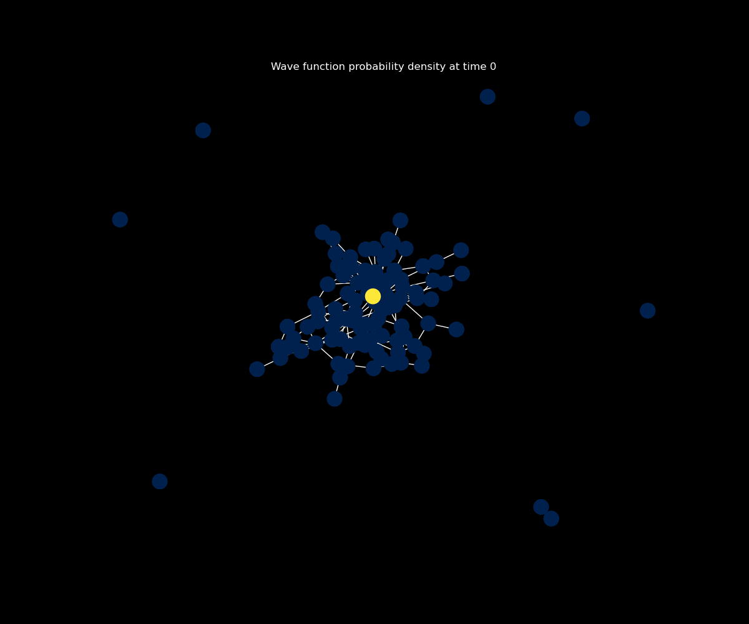
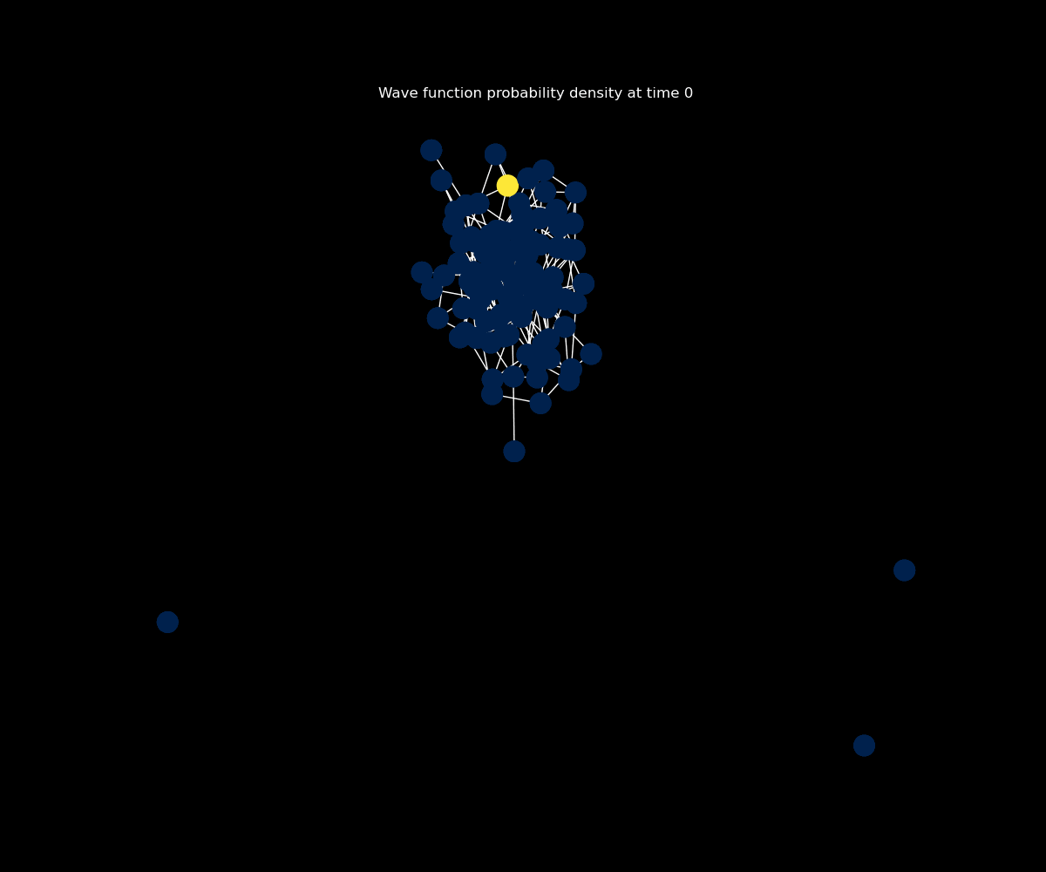
Random Graphs
We generalize even more by simulating the behavior of a wave function on Erdős–Rényi graphs (where you’re given a node set and each possible edge is generated with probability p)
W = 10, p = 0.03
W = 10, p = 0.05
Notes:
Approach used to calculate the electronic band structure of material systems by making approximate wave functions

Slide 12
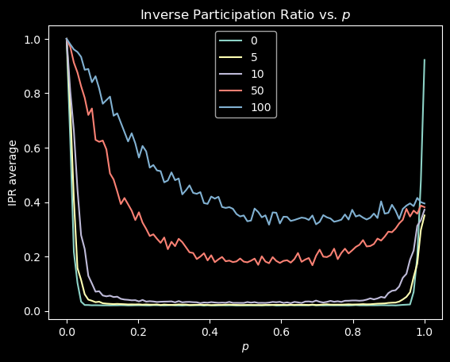
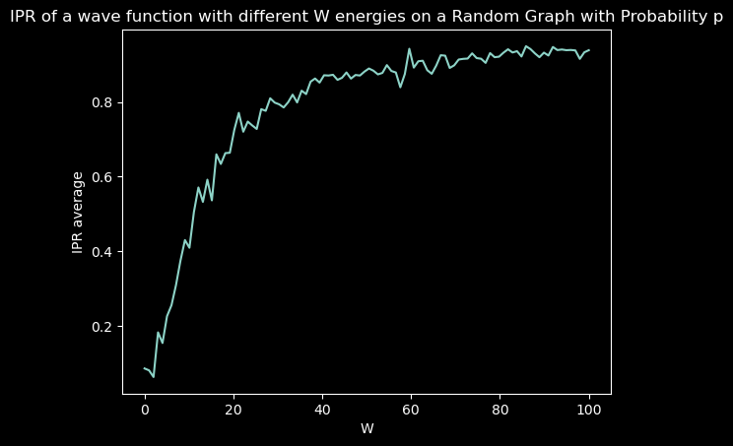
IPR vs. p for different W values
It’s harder to see localization for random graphs, so we lean on IPR more heavily.
We’re interested in how localization changes as the graph becomes more connected (i.e. p increases).
Notes:
Approach used to calculate the electronic band structure of material systems by making approximate wave functions

Slide 13
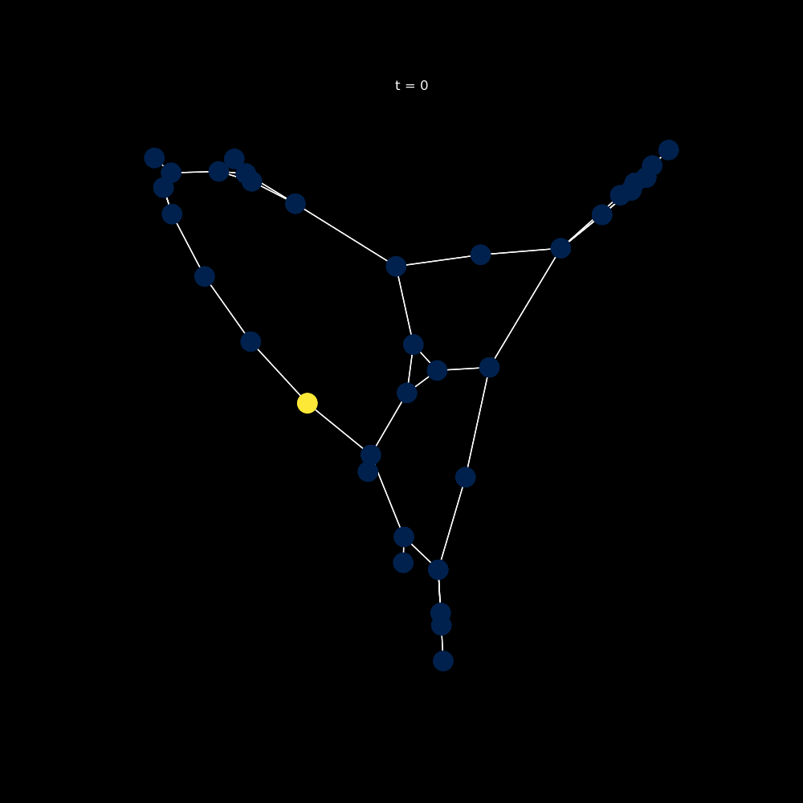
Sparse Graphs
In a restricted domain, do structural (e.g., symmetry) properties of the graph influence localization parameters?
W = 0
W = 18.7
Notes:
Approach used to calculate the electronic band structure of material systems by making approximate wave functions

Slide 14
Future Directions
Correlating & extending analytical predictions made for regular random graphs to specific properties of adjacency matrices.
Why does the IPR vs. W graph dip in the beginning instead of just increasing?
Why does the IPR vs. p graph increase at the end?
Investigate time-dependence of IPR, e.g. test whether noise in IPR vs. W graph disappears over IPR averaged over multiple time points
Investigate different boundary conditions and connections between nodes
Notes:
Approach used to calculate the electronic band structure of material systems by making approximate wave functions

Slide 15
Questions?
Thank you Dr. Gilpin, Anthony, and Edoardo for the fun semester!
Notes:
Approach used to calculate the electronic band structure of material systems by making approximate wave functions

